Slide 1






ASP.NET and Silverlight
Presented By :
Muhammad Atif Hussain
Head of I.T. (Takaful Pakistan Limited)
Technologies Consultant (AUC Technologies)
MCS(KU)
MSCS(SZABIST)
MCP
MCAD
MCSD
MCTS (Windows, Web, Distributed Applications)
MCPD (Enterprise Applications)
MCT(Microsoft Certified Trainer)

Slide 2
Agenda
Visual Studio 2010
What is .NET Framework 4.0
Current Software Development and Design Model
XAML
WPF
Introduction to Silverlight
Silverlight Architecture
Silverlight Development Model
Installation Guidelines

Slide 3
The .NET Framework 4.0
WPF
Win Forms
DLR
ASP.NET
WCF
LINQ
And more!
Base Class Libraries
The CLR
JIT & NGEN
Garbage Collector
Security Model
Exception Handling
Loader & Binder

Slide 4
Microsoft Visual Studio .NET
Development tool that contains a rich set of productivity and debugging features
  Supports managed and unmanaged applications
  Supports C#, C++, VB.NET, …
  Many useful tools and wizards
  Windows Forms Designer
  ASP.NET Web Forms Designer
  Web Services support
  SQL Server integration with ADO.NET and XML
VS.NET is not part of the .NET Framework
  Not necessary to build or run managed code
  The .NET Framework SDK includes command line compilers

Slide 5
VS.NET – Single Development Environment
From Visual Studio.NET you can:
  Write code
  Design user interface
  Study documentation
  Debug
  Test
  Deploy
Same tools for all languages
Same tools for all platforms

Slide 6


Slide 7

Current Model
Design

Slide 8

Current Model
HTML / CSS / Windows Forms / C# / Visual Basic

Slide 9

Current Model
Production Time!

Slide 10


Current Model
Designer
Developer
PSD
AI
ASPX
AJAX
CSS

Slide 11
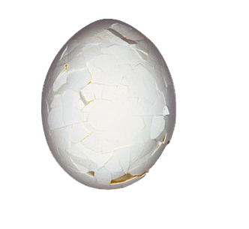
Current Model
Final Result … It Works…

Slide 12
The Good Model
Designer
Developer
XAML
XAML

Slide 13
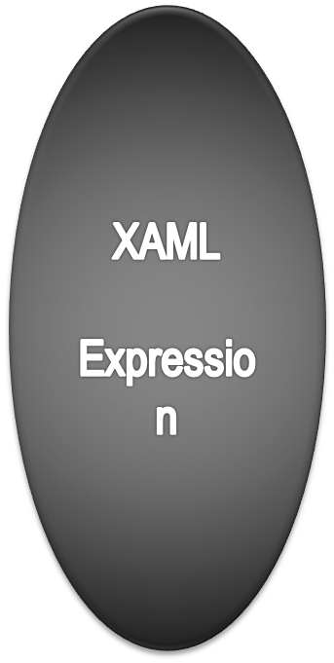
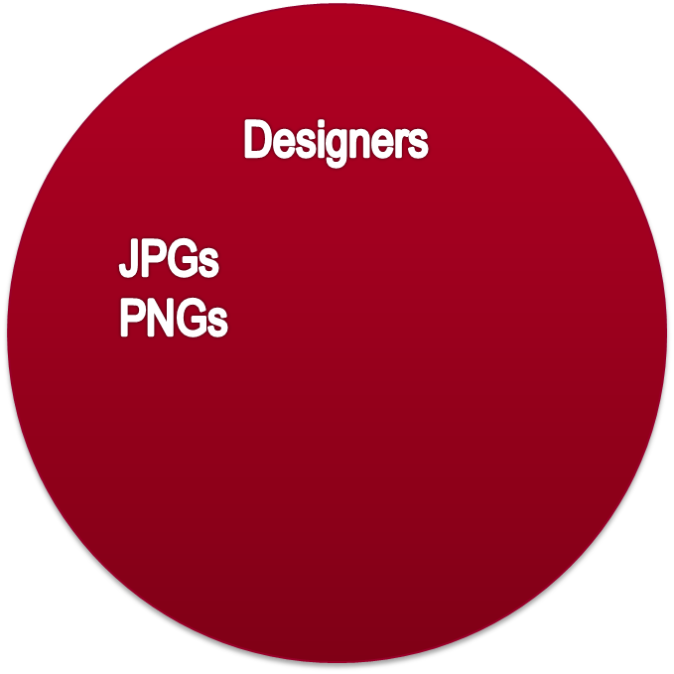
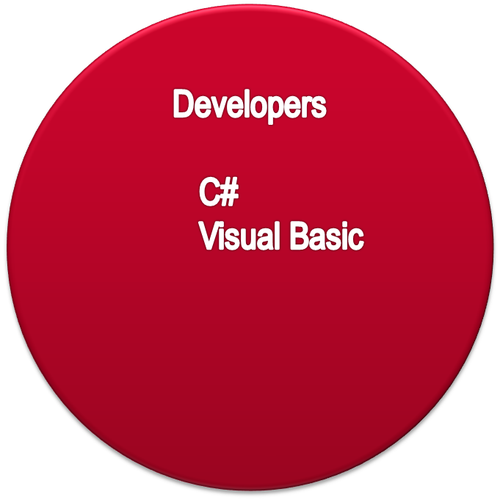
The XAML Way

Slide 14
The XAML Way

Slide 15
XAML (Extended Application Markup Language)
What is XAML?
XAML is a declarative language for user interface design
XAML enables the separation of application design from business logic
XAML and Silverlight
A XAML file defines the user interface that appears as the Silverlight content
  Typically has Canvas as the root element
  Includes namespaces for Silverlight-based applications
Notes:
Module 12: Delivering Dynamic Content with Microsoft Silverlight
Course 2310C
Check if the students are familiar with XAML. Explain that you use XAML to design the UI of a WPF or Silverlight application. Briefly cover the code samples provided but do not go into too much detail at this stage.
Explain that the separation of the UI and the logic that drives it enables designers and developers to work on a project independently. This is emphasized in the lab at the end of the module, where students first design the UI and then add code to implement interactivity. It is also possible to identify event procedures by using XAML. However, this technique produces a tighter coupling between UI and code, which detracts from the initial point.
XAML files are simple because they are just plain text files. However, XAML files can become quite extensive, hence the requirement for a more visual design tool like those available in Expression Studio.
Note: XAML is a core component of the Windows Presentation Foundation that you can use to design the UI of rich Microsoft Windows®-based applications. Therefore, this very powerful markup language is applied to Silverlight to take full advantage of enhanced UI features. XAML is not tied to either just WPF or just Silverlight.
Reference:
http://go.microsoft.com/fwlink/?LinkId=111451

Slide 16


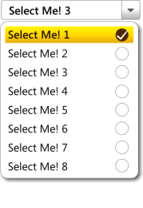

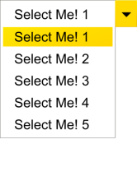




Designer/Developer Experience
The new way for designers and developers to work together
Designer
Developer
  Designers & Developers:
  Speak the same language
Designers Design
Developers add Business Logic

Slide 17
WPF
WPF Overview
Rich and Interactive applications
Vector Graphics
WPF Desktop Applications
WPF Browser Applications
Available Frameworks

Slide 18
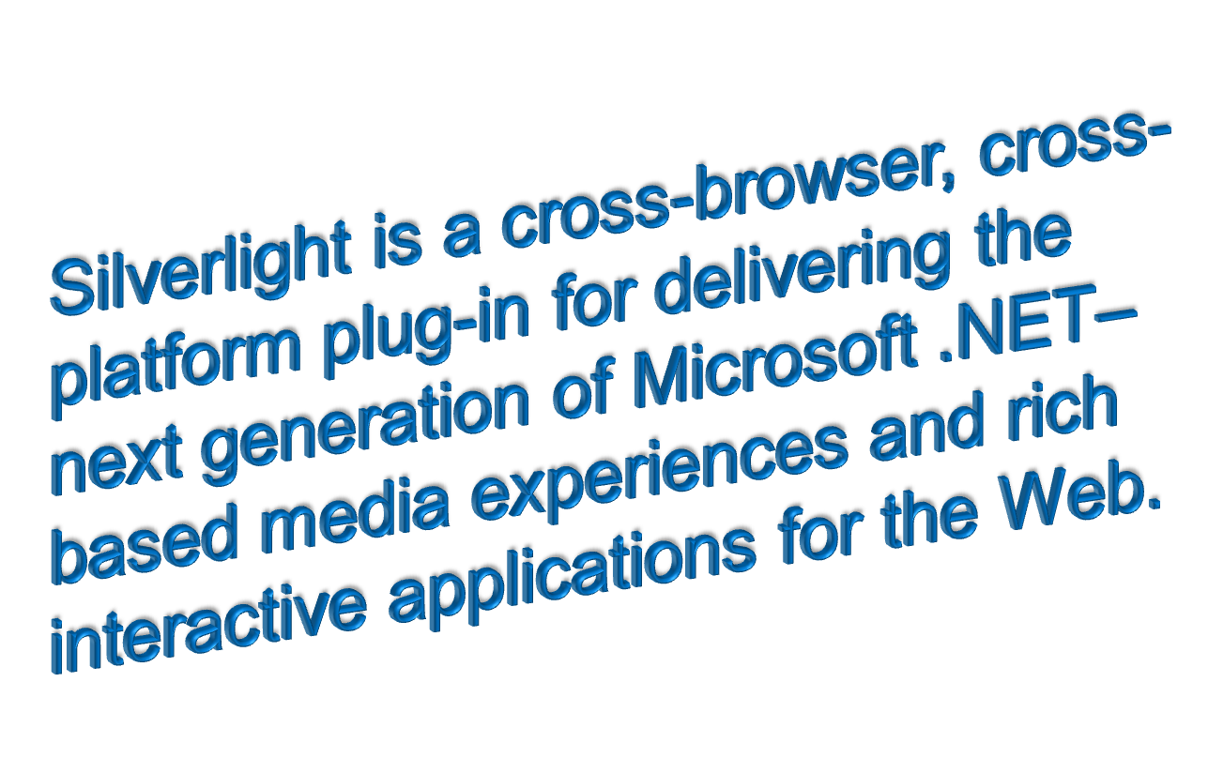
Introduction to Silverlight

Slide 19
















Silverlight Architecture
Data
WPF for Silverlight
.NET for Silverlight
Server
Silverlight 1.0
LINQ
LINQ-to-XML
Extensible Controls
Silverlight 2.0
Web Services
ASP.NET AJAX Libs
Dynamic Languages
BCL
REST
RSS
SOAP
POX
JSON
<asp:xaml>
Ruby
Python
Generics
Collections
<asp:media>
Common Language Runtime
XAML
UI Core
Inputs
Media
Controls
DRM
2D Vectors
Images
Keyboard
WMV / VC1
Layout
Media
Animation
Transforms
Mouse
WMA
Editing
Text
Ink
MP3
Presentation Core
Integrated Networking Stack
DOM Integration
JavaScript Engine
Browser Host
Installer

Slide 20


A Case of mistaken identity
WPF = Silverlight
WPF is more like the father of Silverlight

Slide 21







WPF → Silverlight
WPF
Silverlight 1.0
XAML
XAML + JavaScript
WPF API
Silverlight 2.0
.NET
XAML + .NET

Slide 22
Silverlight Development Model
JavaScript AJAX
  Supported with Silverlight 1.0
  Enables JavaScript to program both HTML and JavaScript together
  Fully supported with ASP.NET AJAX
NET Framework
  Supported with Silverlight 2.0
  Cross platform version of the .NET Framework included with Silverlight
  Fully supports VB , C# and Dynamic Languages development in the browser

Slide 23
How Does Silverlight Work?
Silverlight Framework
This is a reduced framework (currently 4.4 MB)
Still a very rich set of framework objects (Generics, var, LINQ, etc.)
Loads Silverlight app DLL client side (embedded resources)
.NET code runs on client!

Slide 24
Installation Requirements
Mandatory
  Visual Studio 2010 SP1
  Microsoft Silverlight 4.0 (Runtime)
  Microsoft Silverlight 4.0 SDK
  Microsoft Silverlight 4.0 Tools (Package)
Optional
  Microsoft Expression Blend 4.0
  Microsoft Expression Design 4.0
  Microsoft Expression Encoder 4.0 and SDK
  Microsoft Expression Media 4.0
  Microsoft Expression Web 4.0
Fully supports VB , C# and Dynamic Languages development in the browser

Slide 25
Microsoft Silverlight 4.0
Fully supported by Visual Studio and Expression Blend
Major media enhancements
Out of browser support allowing Web applications to work on the desktop
Significant graphics improvements including 3D graphics support
GPU acceleration and H.264 video support
Improve RIA development productivity
Visual Studio 2010 will support a fully editable and interactive designer for Silverlight

Slide 26
Microsoft Silverlight 4.0
Support for Higher Quality Video & Audio: With support for native H.264/Advanced Audio Coding (AAC) Audio, live and on-demand IIS7 Smooth Streaming, full HD (720p+) playback, and an extensible decoder pipeline, Silverlight 3 brings rich, full-screen, stutter-free media experiences to the desktop. New and enhanced media features in Silverlight 3 include:
  Live and on-demand true HD (720p+) Smooth Streaming. IIS Media Services (formerly IIS Media Pack), an integrated HTTP media delivery platform, features Smooth Streaming which dynamically detects and seamlessly switches, in real time, the video quality of a media file delivered to Silverlight based on local bandwidth and CPU conditions.
  More format choice. In addition to native support for VC-1/WMA, Silverlight 3 now offers users native support for MPEG-4-based H.264/AAC Audio, enabling content distributors to deliver high-quality content to a wide variety of computers and devices.
  True HD playback in full-screen. Leveraging graphics processor unit (GPU) hardware acceleration, Silverlight experiences can now be delivered in true full-screen HD (720p+).
  Extensible media format support. With the new Raw AV pipeline, Silverlight can easily support a wide variety of third-party codecs. Audio and video can be decoded outside the runtime and rendered in Silverlight, extending format support beyond the native codecs.
  Industry leading content protection. Silverlight DRM, Powered by PlayReady Content Protection enables protected in-browser experiences using AES encryption or Windows Media DRM.

Slide 27
Microsoft Silverlight 4.0
Empowering Richer Experiences: Silverlight 3 contains new 3D graphics, animation features, hardware accelerated effects and text improvements that enable designers and developers to create next generation Web visuals. Additional features include:
  Perspective 3D Graphics. Silverlight 3 allows developers and designers to apply content to a 3D plane. Users can rotate or scale live content in space without writing any additional code. Other effects include creating a queue in 3D and transitions.
  Pixel Shader effects. These software based effects include blur and drop shadow. In addition, you can also write your own effect. Effects can be applied to any graphical content. An example would be to make a button appear depressed on rollover you could use a drop shadow effect on the pressed visual state.
  Bitmap Caching. Silverlight 3 dramatically improves the rendering performance of applications by allowing users to cache vector content, text and controls into bitmaps. This feature is useful for background content and for content which needs to scale without making changes to its internal appearance.
  New Bitmap API. With Silverlight 3, developers can now write pixels to a bitmap. Thus, they can build a photo editor to do red eye correction, perform edits on scanned documents or create specials effects for cached bitmaps from elements on the screen.

Slide 28
Microsoft Silverlight 4.0
  Empowering Richer Experiences (continued):
  Themed application support. Developers can now theme applications by applying styles to their Silverlight 3 applications and changing them at runtime. Additionally, developers can cascade styles by basing them on each other.
  Animation Effects. Silverlight 3 provides new effects such as spring and bounce. These make animation more natural. Developers can also now develop their own mathematical functions to describe an animation.
  Enhanced control skinning. Silverlight 3 provides easier skinning capabilities by keeping a common set of controls external from an application. This allows the sharing of styles and control skins between different applications.
  Improved text rendering & font support. Silverlight 3 allows far more efficient rendering and rapid animation of text. Applications also load faster by enabling the use of local fonts.

Slide 29
Microsoft Silverlight 4.0
Improving Rich Internet Application Productivity. New features include:
  60+ controls with source code : Silverlight 3 is packed with over 60 high-quality, fully skinnable and customizable out-of-the-box controls such as charting and media, new layout containers such as dock and viewbox, and controls such as autocomplete, treeview and datagrid. The controls come with nine professional designed themes and the source code can be modified/recompiled or utilized as-is. Other additions include multiple selection in listbox controls, file save dialog making it easier to write files, and support for multiple page applications with navigation.
  Deep Linking. Silverlight 3 includes support for deep linking, which enables bookmarking a page within a RIA.
  Search Engine Optimization (SEO). Silverlight 3 enables users to solve the SEO-related challenges posed by RIAs. By utilizing business objects on the server, together with ASP.NET controls and site maps, users can automatically mirror database-driven RIA content into HTML that is easily indexed by the leading search engines.

Slide 30
Microsoft Silverlight 4.0
Enhanced Data Support: Silverlight 3 delivers:
  Element to Element binding : UI designers use binding between two UI properties to create compelling UI experiences. Silverlight now enables property binding to CLR objects and other UI components via XAML, for instance binding a slider value to the volume control of a media player.
  Data Forms. The Data Form control provides support for layout of fields, validation, updating and paging through data.
  New features for data validation which automatically catch incorrect input and warn the user with built-in validation controls.
  Support for business objects on both client and server with n-Tier data support. Easily load, sort, filter and page data with added support for working with data. Includes a new built-in CollectionView to perform a set of complex operations against server side data. A new set of .NET RIA services supports these features on the server.

Slide 31
Microsoft Silverlight 4.0
Improved performance, through:
  Application library caching, which reduces the size of applications by caching framework on the client in order to improve rendering performance.
  Enhanced Deep Zoom, allows users to fluidly navigate through larger image collections by zooming.
  Binary XML allows communication with the server to be compressed, greatly increasing the speed at which data can be exchanged.
  Local Connection This feature allows communication between two Silverlight applications on the client-side without incurring a server roundtrip: for instance a chart in one control can communicate with a datagrid in another.
Advanced Accessibility Features:
  Silverlight 3 is the first browser plug-in to provide access to all system colors, allowing partially-sighted people to make changes such as high contrast color schemes for ease of readability by using familiar operating system controls.

Slide 32
Microsoft Silverlight 4.0
Out of Browser Capabilities. The new out of browser experience in Silverlight 3 enables users to place their favorite Silverlight applications directly onto their PC and Mac, with links on the desktop and start menu—all without the need to download an additional runtime or browser plug-in. Further, the new experience enables Silverlight applications to work whether the computer is connected to the Internet or not—a radical improvement to the traditional Web experience. Features include:
  Life outside the browser. Silverlight applications can now be installed to and run from the desktop as lightweight web companions. Thus, users can take their favorite Web applications with them, regardless of whether they are connected to the Internet or not.
  Desktop shortcuts and start menu support. Silverlight applications can be stored on any PC or Mac computer’s desktop with links in the start menu and applications folder, and so are available with one-click access.
  Safe and secure. Leveraging the security features of the .NET Framework, Silverlight applications run inside a secure sandbox with persistent isolated storage. These applications have most of the same security restrictions as traditional web apps and so can be trusted without security warnings or prompts, minimizing user interruptions.
  Smooth installation. Because Silverlight applications are stored in a local cache and do not require extra privileges to run, the installation process is quick and efficient.
  Auto-update. Upon launch, Silverlight applications can check for new versions on the server, and automatically update if one is found.
  Internet connectivity detection. Silverlight applications can now detect whether they have Internet connectivity and can react intelligently including caching a users’ data until their connection is restored.

Slide 33
Microsoft Expression Blend 4.0
Microsoft Expression Blend is a full-featured professional design tool for creating engaging and sophisticated user interfaces for Microsoft Windows-based and Microsoft Silverlight-based applications. By separating project files by role, Expression Blend lets designers focus on creativity and developers focus on programming. Each team member can work without blocking the other’s progress.
In Expression Blend, you design your application visually, drawing shapes, paths, and controls on the artboard, and then modifying their appearance and behavior. You can import images, video, and sound. In Windows-based applications, you can also import and change 3D objects.
You can create storyboards that animate the visual or audio elements of your design, and optionally trigger those storyboards when users interact with your application. When you work on Windows-based or Silverlight 4.0 based applications, you can redesign the templates that are applied to basic controls so that your application looks and behaves uniquely.

Slide 34
Microsoft Expression Blend 4.0
New Features in Expression Blend 3:
The designer-developer workflow took another major step forward today with major innovations in Expression Blend 3 including: SketchFlow, a rapid prototyping capability that makes it easy to communicate design intent to stakeholders; design time sample data that enables the design and testing of applications without access to live data; direct import of Adobe Photoshop and Illustrator files; behaviors, extensible and reusable components that add interactivity to applications without writing code; a full code editor supporting C#, VB and XAML; and many more features that support an improved design and development experience. Features include:
SketchFlow. SketchFlow introduces a new set of features designed to make it easier for you to experiment with dynamic user experiences and create compelling prototypes. SketchFlow also helps communicate design ideas to other stakeholders, and makes it easier to collect in-context annotated feedback. SketchFlow enables the navigation and composition of an application to be modeled in a very visual manner from a simple prototype that uses a series of sketches, to something much more evolved. A prototype can be made as real and interactive as it needs to be to communicate design intent and SketchFlow can leverage all the existing features of Expression Blend.

Slide 35
Microsoft Expression Blend 4.0
Adobe Photoshop and Illustrator import. The powerful importers for both Adobe Photoshop and Adobe Illustrator enable smooth integration with workflows the designer already has in place. The designer has freedom to view and import Photoshop files layer by layer. Layers can be easily regrouped and elements retain their original formats; layers, layer positions, editable text and vectors remain available for editing within Expression Blend.
Behaviors. Add interactivity to your application, without having to write code. Behaviors can encapsulate complex design interactions into reusable components which can be directly applied to a user interface element in the application. Developers have access to a rich API that they can use to write their own triggers, actions, and behaviors for use in their Silverlight and WPF projects.
Sample data. Design time sample data makes it easy to build data-connected applications without access to live data. You can generate sample data or import sample data from an XML file and is available to controls on the artboard at design-time. You can extensively customize your sample data details, and you can easily switch between using sample data and using live data at run-time.

Slide 36
Microsoft Expression Blend 4.0
Improved design and development experience. Expression Blend 3 includes many features that improve the overall design experience including a brand new design surface making Blend more accessible to visual designers. Team Foundation Server support allows easier integration of the Blend user into Team System. Improved animation and easing functions, 3D transforms, visual effects and an improved visual state manager enable a great tooling experience.
The above features with the exception of SketchFlow and Behaviors are available in the Expression Blend 3 Preview. Both SketchFlow and a complete selection of Behaviors will be available in a forthcoming Beta release of Blend 3.

Slide 37
Microsoft Expression Design 4.0
Expression Design is a tool for creative professionals and developers who want to build graphics for application user interfaces, the web, or any other medium. Expression Design offers powerful features to help you express your creativity.
The drawing tools in Expression Design help you seamlessly blend vector paths and bitmapped images together for unprecedented flexibility. The convenience and editability of vector graphics in Expression Design can be a cornerstone of your Windows Presentation Foundation (WPF), Microsoft Silverlight, and web images. Whether you're a veteran professional illustrator, a designer building a dazzling website, or a budding artist eagerly experimenting with various styles and techniques, you will find Expression Design an indispensable tool for your creative tasks.

Slide 38
Microsoft Expression Encoder 4.0
Microsoft Expression Encoder is an advanced and essential tool for bringing your edited video project to the Web for playback in Microsoft Silverlight scenarios. Silverlight is a cross-platform technology that supports a true subset of the XML-based XAML (Extensible Application Markup Language). Silverlight enables next generation, rich Web client experiences, and delivers a lightweight client that supports vector graphics, 2D animation, rich audio/video integration, and a rich .NET Framework programming model. Silverlight is cross-platform and cross-browser, supporting Windows Vista, Windows XP, and Apple Macintosh OS X 10.4.8, and supporting playback in all versions of Microsoft Internet Explorer, Mozilla Firefox, and Apple Safari.

Slide 39
Microsoft Expression Media 4.0
Microsoft Expression Media is a fast and easy way to view, organize, and present the growing number of images, movies, sounds, fonts, and other media files that you have created or acquired. Whether you are a student, journalist, multimedia enthusiast, or creative professional, you want to be able to organize and browse your images, movies, and documents. Expression Media enables you to do those things, as well as enabling you to modify and share your media files in almost any multimedia or document format that you want.

Slide 40
Microsoft Expression Web 4.0
A full-featured professional design tool for creating engaging and sophisticated standards-based websites.
PHP
Byte Order Mark Option
Silverlight
Flash and Window Media
Photoshop Import
ASP.NET AJAX
Custom ASP.NET Controls
ASP.NET Data Controls
FTP Publishing
CSS
HTML File Extension
Alphabetized HTML Attributes

Slide 41
What Next?

Slide 42
Silverlight 4.0?

Slide 43
Thanks God
Its in beta

Slide 44
Links
http://silverlight.net/
http://silverlight.net/GetStarted/
http://www.microsoft.com/silverlight/
http://msdn2.microsoft.com/en-us/silverlight/default.aspx

Slide 45


Slide 46
Questions
?

